Slide 2
Welcome to all
for the Advertising Online lecture
By
Dr. Dhiraj Ovhal
HOD of Commerce

Slide 4
(Way to remember :- MAP FACT SOS
 | Advertising | Salesmanship
1 | Meaning :- Sale of product through Advertising. | Sale of product through Salesmanship
2 | Audience:- Mass/ large audience | Individual/ Single Customer
3 | Product demonstration :- Not possible | Possible
4 | Feedback :- Not possible | Possible
5 | Area Coverage:- Wider from local to Regional, national to international | One place at time
6 | Cost per person basis:- low | High
7 | Time for the advertising:- Any time before or after product launch in the market | Only after Launched products in the market
8 | Sale:- No immediate sale | immediate sale
9 | On the spot clarification:- Not possible | Possible
10 | Suitable to Firm:- Large business firm | Small and large business firm

Slide 5
Advertising:-
Meaning :- Sale of product through Advertising.
Audience:- Mass/ large audience
Product demonstration :- Not possible
Feedback :- Not possible
Area Coverage:- Wider from local to Regional,
National to International
Cost per person basis:- low
Time for the advertising:- Any time before or
after product launch in the market
Sale:- No immediate sale
On the spot clarification:- Not possible
Suitable to Firm:- Large business firm

Slide 6
Salesmanship / Personal Selling :-
Meaning :- Sale of product through Salesmanship
Audience:- Individual/ Single Customer
Product demonstration :- Possible
Feedback :- Possible
Area Coverage:- One place at time
Cost per person basis:- High
Time for the advertising:- Only after Launched products in the market
Sale:- Immediate sale
On the spot clarification:- Possible
Suitable to Firm:- Small & Large business firm

Slide 7
Q.3 Distinguish between Advertising Vs Salesmanship ( Personal Selling)?
Way to remember :- MAP FACT SOS
Meaning :-
Advertising means promotion and sale of products and services through advertising.
Salesmanship means sale of product through salesmen.
MAP:- Meaning , Audience, Product demonstration
FACT:- Feedback, Area Coverage, Cost per person basis, Time
for the advertising
SOS :- Sale, On the spot clarification, Suitable to Firm

Slide 8
Attendance Link
https://forms.gle/U4Da9ykpniL3tpCdA
(Mention date at last point)

Slide 9
Thank You

Slide 10
Go to www.menti.com
and use the code 2022 5350

Slide 11
Thank You

Slide 12
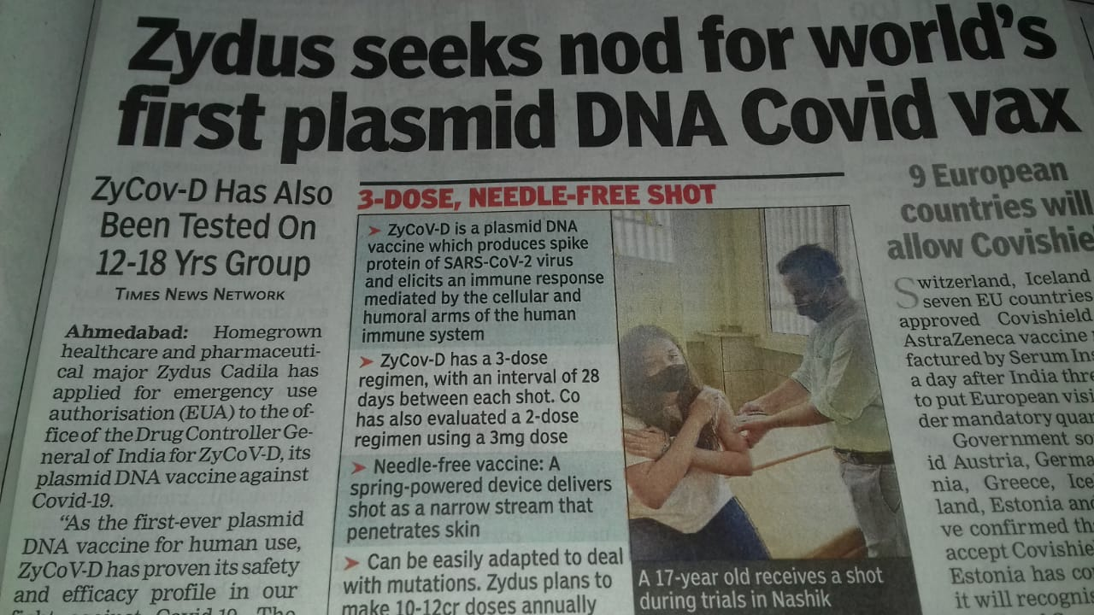
Thank You

Slide 13
Thank You

Slide 14
Thank You

